Slide 1
Computer Science Parallel and Distributed Computation Message Passing Interface (MPI)
Kun Suo
Computer Science, Kennesaw State University
https://kevinsuo.github.io/

Slide 2
Review
MPI introduction
Helloworld of MPI
Performance evaluation
Example: how to solve problems in MPI
Trapezoidal problem

Slide 3
Outline
MPI_Send/MPI_Receive
MPI_Reduce/MPI_Allreduce
MPI_Broadcast
MPI_Scatter
MPI_Gather

Slide 4
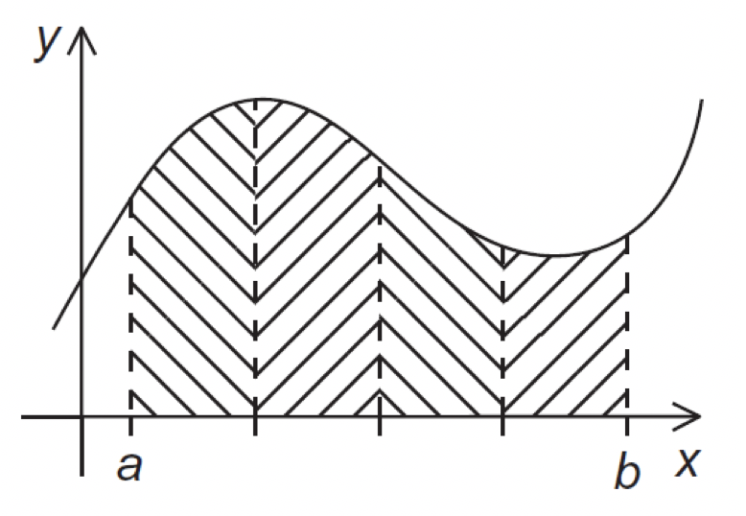

Communication
I send
I send
Rank = 1
Rank = 2
Rank = n
I receive
Rank = 0

Slide 5
Point-to-Point communication
I send
Rank = 1
Rank = 2
…
Rank = 7
I receive
Rank = 0
How many send/receive and add operation?
7 sends and 7 receives
7 adds

Slide 6
Point-to-Point communication
I send
Rank = 1
Rank = 2
…
Rank = 7
I receive
Rank = 0
How many send/receive and add operation on master node (Rank = 0)?
7 sends and 7 receives
7 adds

Slide 7
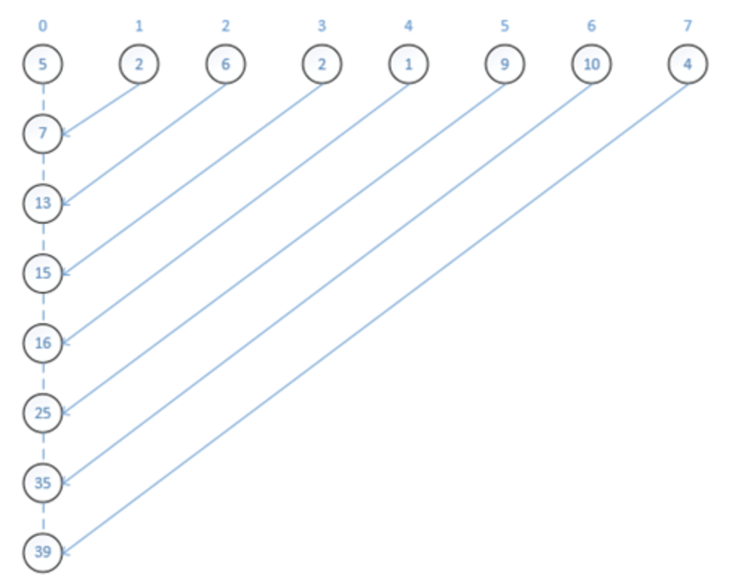
Point-to-Point communication
How many send/receive and add operation on master node (Rank = 0)?
7 sends and 7 receives
7 adds

Slide 8




Tree-structured communication
In the first phase:
(a) Process 1 sends to 0; 3 sends to 2; 5 sends to 4; and 7 sends to 6.
(b) Processes 0, 2, 4, and 6 add in the received values.
(c) Processes 2 and 6 send their new values to processes 0 and 4, respectively.
(d) Processes 0 and 4 add the received values into their new values.

Slide 9
Tree-structured communication
In the first phase:
(a) Process 1 sends to 0; 3 sends to 2; 5 sends to 4; and 7 sends to 6.
(b) Processes 0, 2, 4, and 6 add in the received values.
(c) Processes 2 and 6 send their new values to processes 0 and 4, respectively.
(d) Processes 0 and 4 add the received values into their new values.

Slide 10


Tree-structured communication
In the first phase:
(a) Process 1 sends to 0; 3 sends to 2; 5 sends to 4; and 7 sends to 6.
(b) Processes 0, 2, 4, and 6 add in the received values.
(c) Processes 2 and 6 send their new values to processes 0 and 4, respectively.
(d) Processes 0 and 4 add the received values into their new values.

Slide 11
Tree-structured communication
In the first phase:
(a) Process 1 sends to 0; 3 sends to 2; 5 sends to 4; and 7 sends to 6.
(b) Processes 0, 2, 4, and 6 add in the received values.
(c) Processes 2 and 6 send their new values to processes 0 and 4, respectively.
(d) Processes 0 and 4 add the received values into their new values.

Slide 12

Tree-structured communication
In the second phase:
(a) Process 4 sends its newest value to process 0.
(b) Process 0 adds the received value to its newest value.

Slide 13
Tree-structured communication
In the second phase:
(a) Process 4 sends its newest value to process 0.
(b) Process 0 adds the received value to its newest value.

Slide 14
Tree-structured communication
How many send/receive and add operation?
7 sends and 7 receives
7 adds

Slide 15
Tree-structured communication
How many send/receive and add operation on master node (Rank = 0)?
3 sends and 3 receives
3 adds

Slide 16
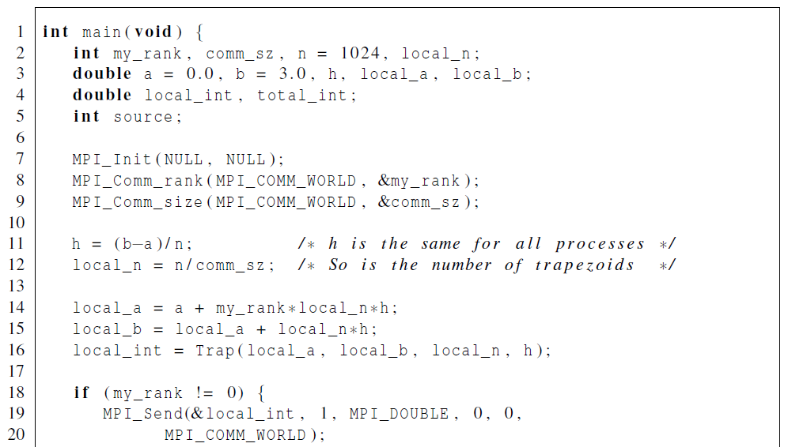
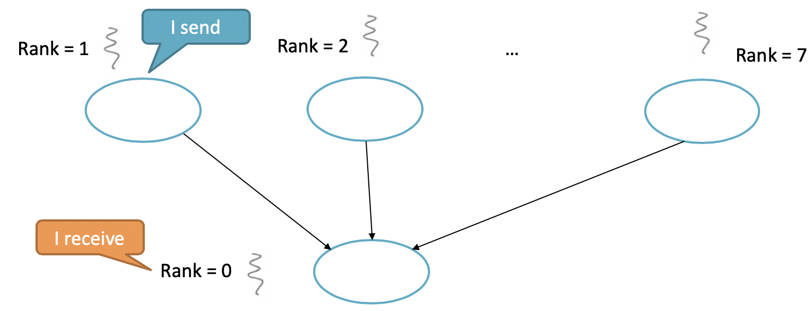
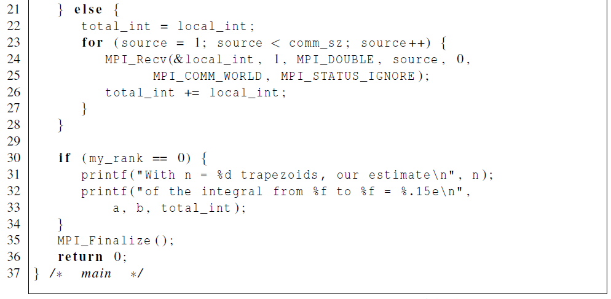
Point-to-Point communication code

Slide 17
Collective (tree-structure) communication code
MPI_Reduce(&local_int, &total_int,
1, MPI_DOUBLE,
MPI_SUM, 0, MPI_COMM_WORLD);

Slide 18
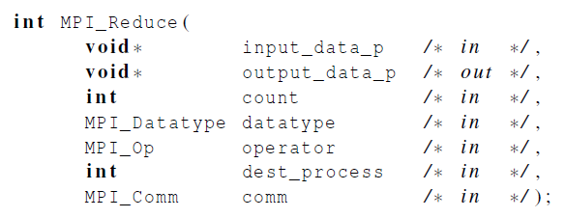
MPI_Reduce
input
output
Will do sum up for the inputs
Process 0 will do it

Slide 19
MPI_Reduce
input
output
Will do sum up for the inputs
Process 0 will do it

Slide 20
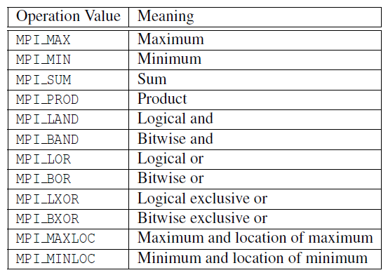
Besides Sumup, it can also do:

Slide 21
Besides Sumup, it can also do:
MPI_Reduce(&local_int, &total_int,
1, MPI_DOUBLE,
MPI_MAX, 0, MPI_COMM_WORLD);
MPI_Reduce(&local_int, &total_int,
1, MPI_DOUBLE,
MPI_MIN, 0, MPI_COMM_WORLD);
MPI_Reduce(&local_int, &total_int,
1, MPI_DOUBLE,
MPI_PROD, 0, MPI_COMM_WORLD);
Rank = 1
Rank = 2
…
Rank = 7
x1
x2
x7
MAX(x1, x2, …, x7)
MIN(x1, x2, …, x7)
x1 * x2 * … * x7

Slide 22
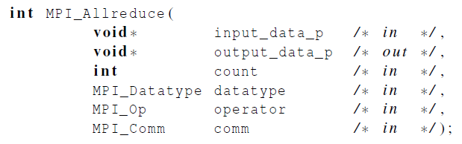
MPI_Allreduce
Useful in a situation in which all of the processes need the final result.
Sum up first and then distribute to everyone

Slide 23
A global sum followed by distribution of the result
Sum up
Distribution
9 is distributed to every process

Slide 24
What if I only need to distribute?
MPI_Reduce
MPI_Allreduce
?

Slide 25
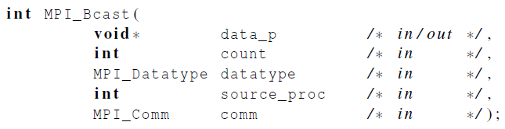
Broadcast
Data belonging to a single process is sent to all of the processes in the communicator.

Slide 26

A tree-structured broadcast

Slide 27
Example of MPI_Bcast
Rank = 0
{3,6,9}
MPI_Bcast
Rank = 1
Rank = 2
…
Rank = 7
{3,6,9}
{3,6,9}
{3,6,9}

Slide 28
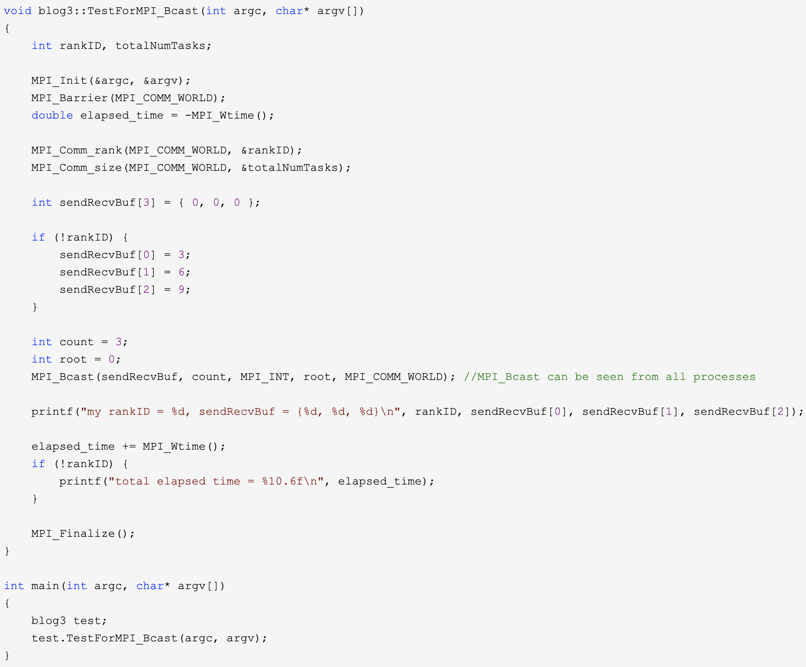
Example of MPI_Bcast

Slide 29
Example of MPI_Bcast
buffer is {0,0,0}
rankID = 0 will inits buffer as {3,6,9}
Print the received data

Slide 30
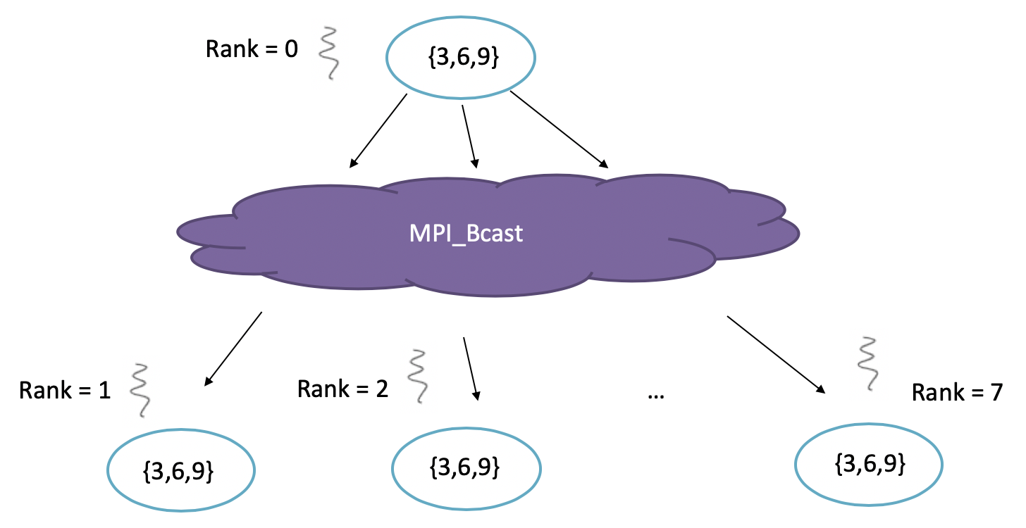
Example of MPI_Bcast

Slide 31
What if I only need to distribute?
MPI_Reduce
MPI_Allreduce
MPI_Bcast

Slide 32
Data distributions: vector addition

Slide 33
Partitioning options
Block partitioning
Assign blocks of consecutive components to each process.
Cyclic partitioning
Assign components in a round robin fashion.
Block-cyclic partitioning
Use a cyclic distribution of blocks of components.

Slide 34
Partitioning options
Block partitioning vs Cyclic partitioning

Slide 35
Partitioning options
Block partitioning vs Cyclic partitioning

Slide 36
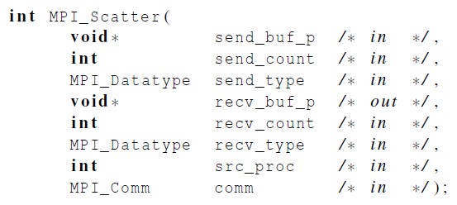
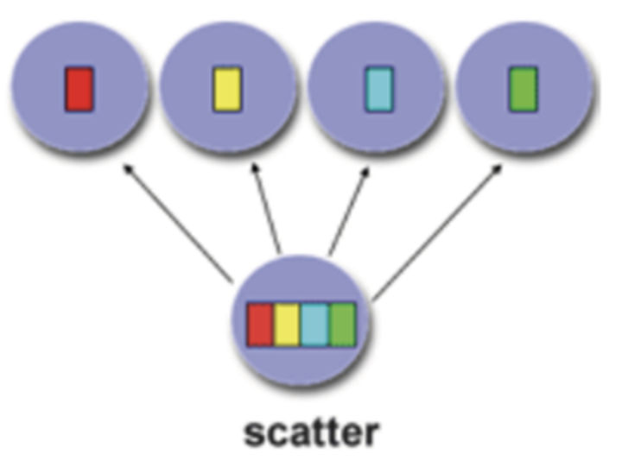
Scatter: partition & distribution
MPI_Scatter can be used in a function that reads in an entire vector on process 0 but only sends the needed components to each of the other processes.
sendCount, each process gets n data

Slide 37
Example of MPI_Scatter
1 | 2 | 3 | 4
5 | 6 | 7 | 8
9 | 10 | 11 | 12
13 | 14 | 15 | 16
Rank = 0
…
Rank = 1
Rank = 2
Rank = 7

Slide 38
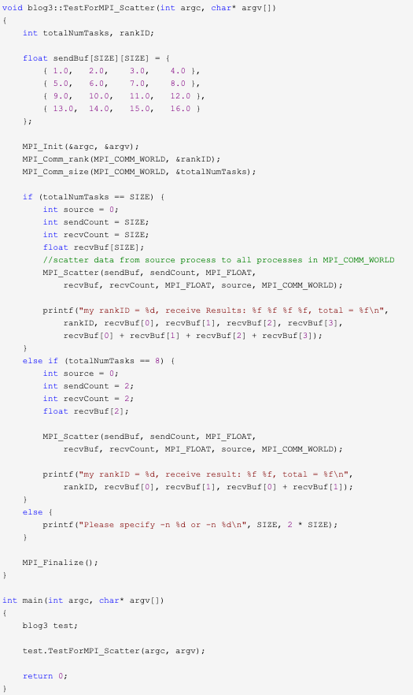
Example of MPI_Scatter
Size = 4
1 | 2 | 3 | 4
5 | 6 | 7 | 8
9 | 10 | 11 | 12
13 | 14 | 15 | 16

Slide 39
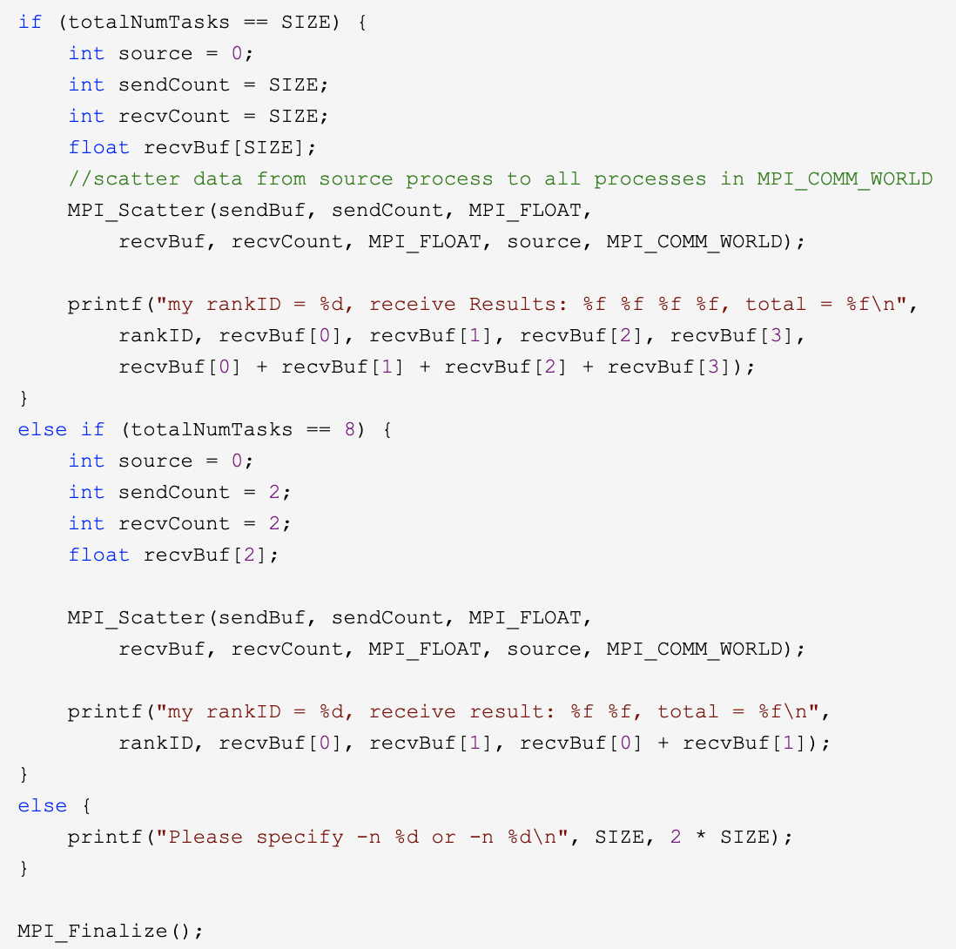


Example of MPI_Scatter
1 | 2 | 3 | 4
5 | 6 | 7 | 8
9 | 10 | 11 | 12
13 | 14 | 15 | 16
Size = 4
sendCount = 2, each process gets 2 data
After each process receives the data, sum them up

Slide 40
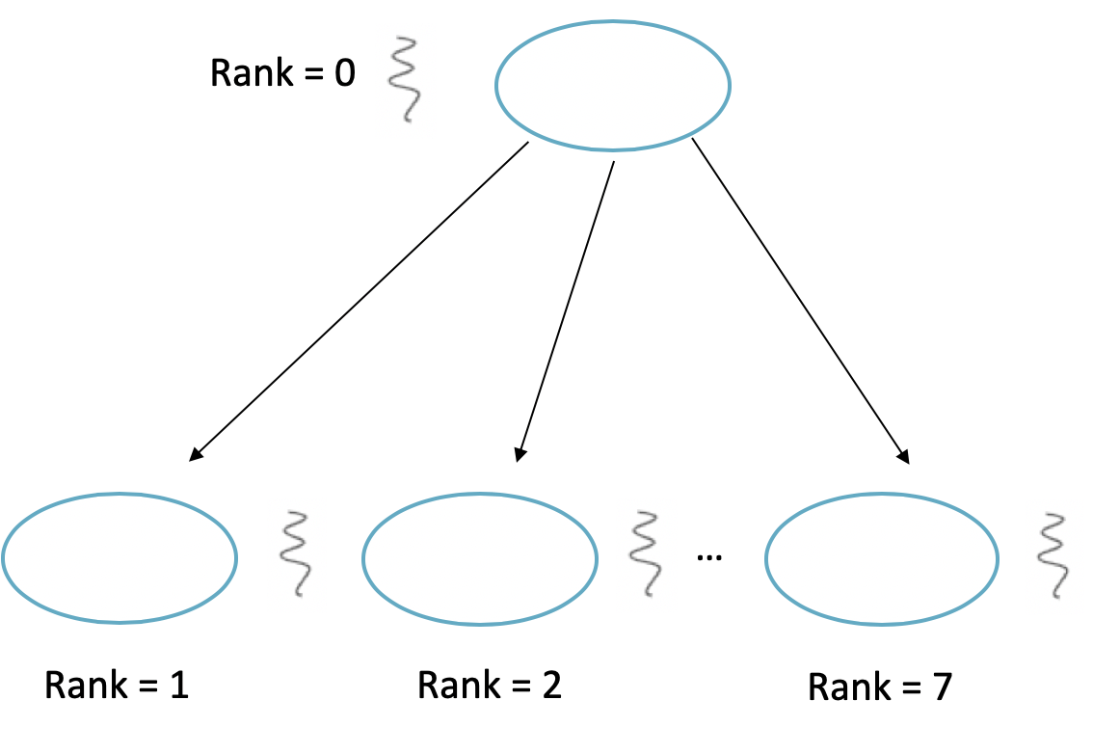
Example of MPI_Scatter
1 | 2 | 3 | 4
5 | 6 | 7 | 8
9 | 10 | 11 | 12
13 | 14 | 15 | 16

Slide 41
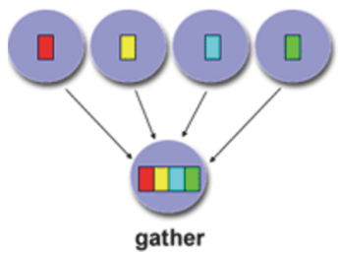
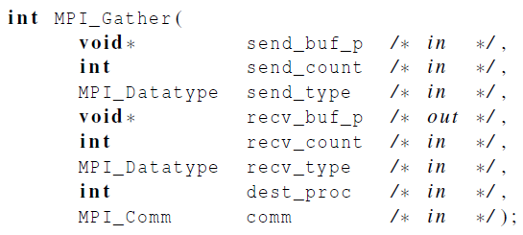
Gather
Collect all of the components of the vector onto process 0, and then process 0 can process all of the components.
Send data
Receiver ID

Slide 42
Example of MPI_Gather
Rank = 0
Each process sends its rankID to the array in process 0
…
Rank = 1
Rank = 2
Rank = 7

Slide 43
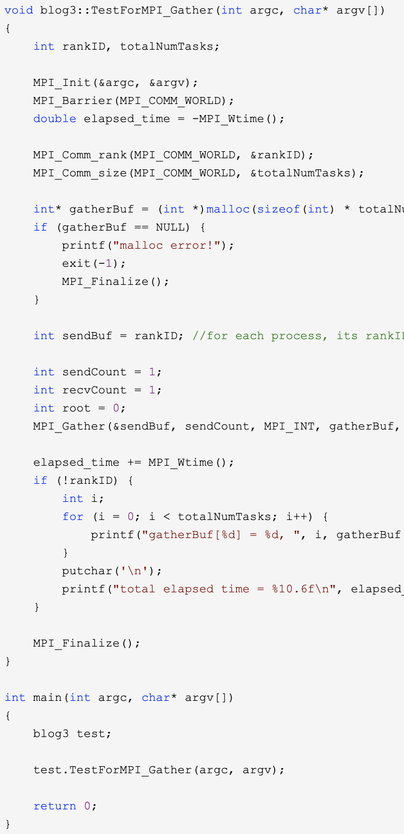
Example of MPI_Gather

Slide 44
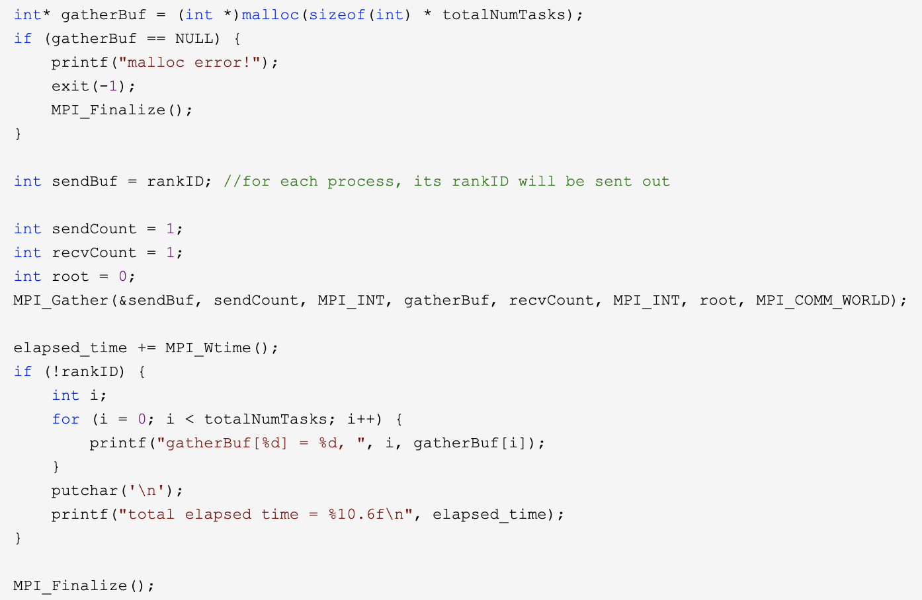
Example of MPI_Gather
The sent content is the rankID
The sent content is the rankID
Receiver is process 0
Data size is 1

Slide 45
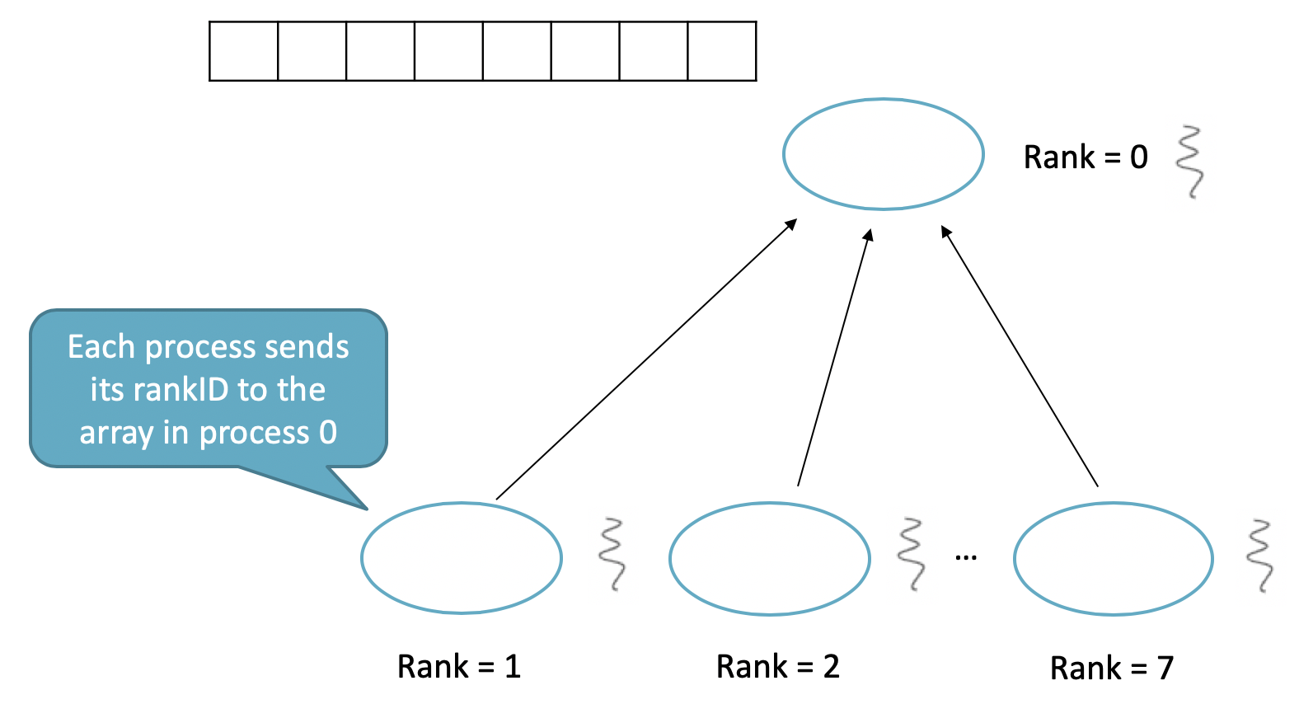
Example of MPI_Gather
0 | 1 | 2 | 3 | 4 | 5 | 6 | 7

Slide 46
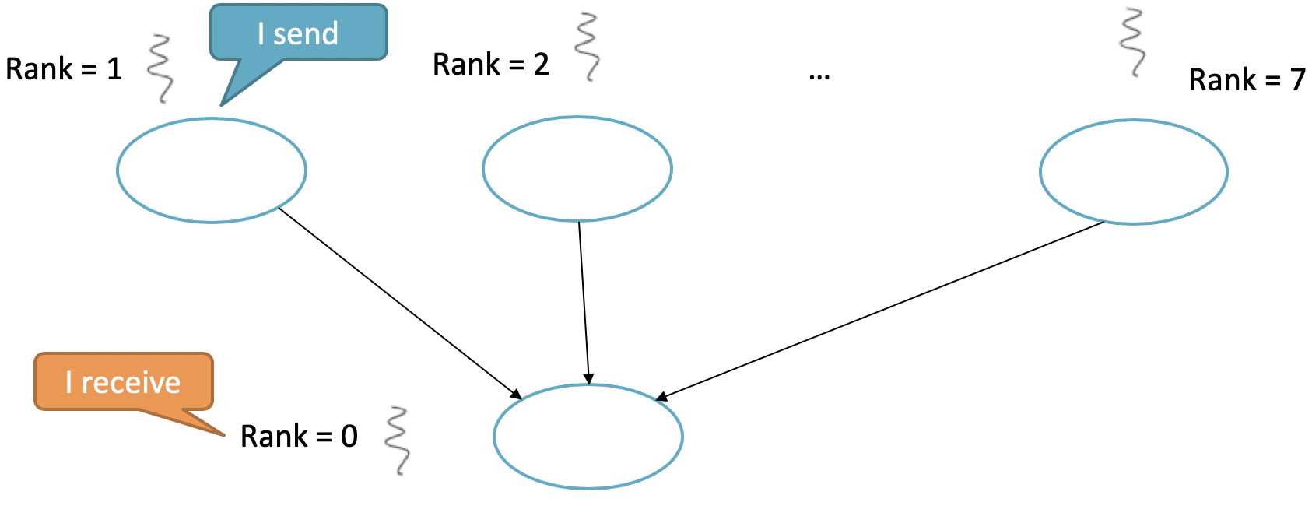
Conclusion
Point-to-Point communication
MPI_Send
MPI_Receive
MPI_Reduce
MPI_Bcast

Slide 47
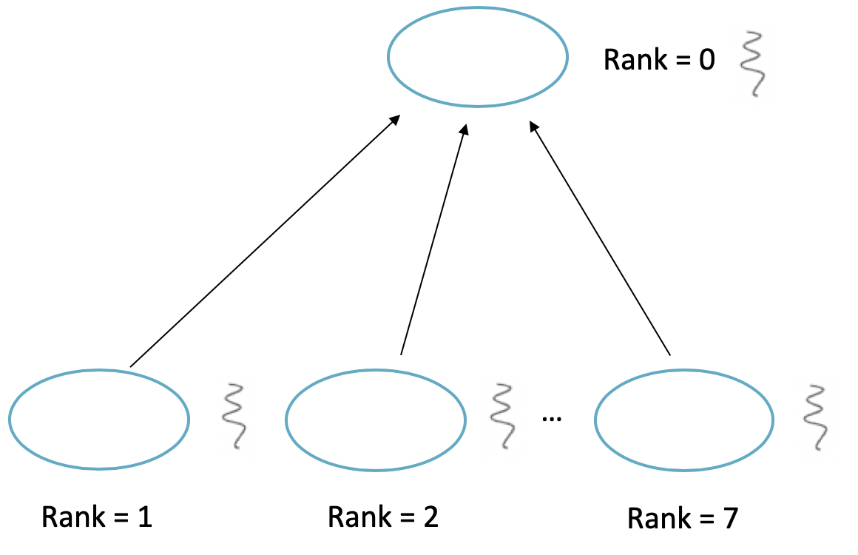
Conclusion
MPI_Scatter
MPI_Gather

Slide 48
What is the Difference between Point-to-Point communication and MPI_Gather?
Point-to-Point communication
MPI_Send
MPI_Receive
Message can be different contents and formats
Message must be same formats
MPI_Gather

Slide 49
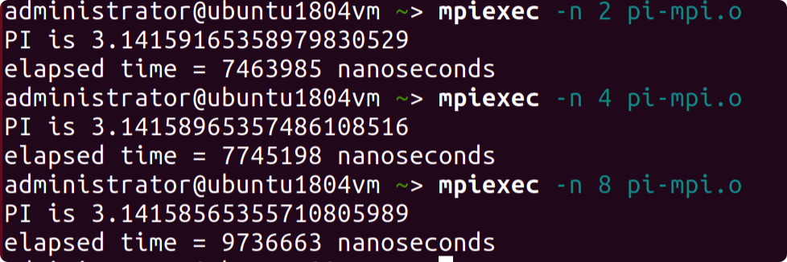



Hint of Project
Result in a.aa:
2 digits
3.332 ≈ 3.33 + 1.999 = 5.329 ≈ 5.33
1.555 + 1.777 + 1.999 = ?
3.776 ≈ 3.78 + 1.555 = 5.335 ≈ 5.34

Slide 50
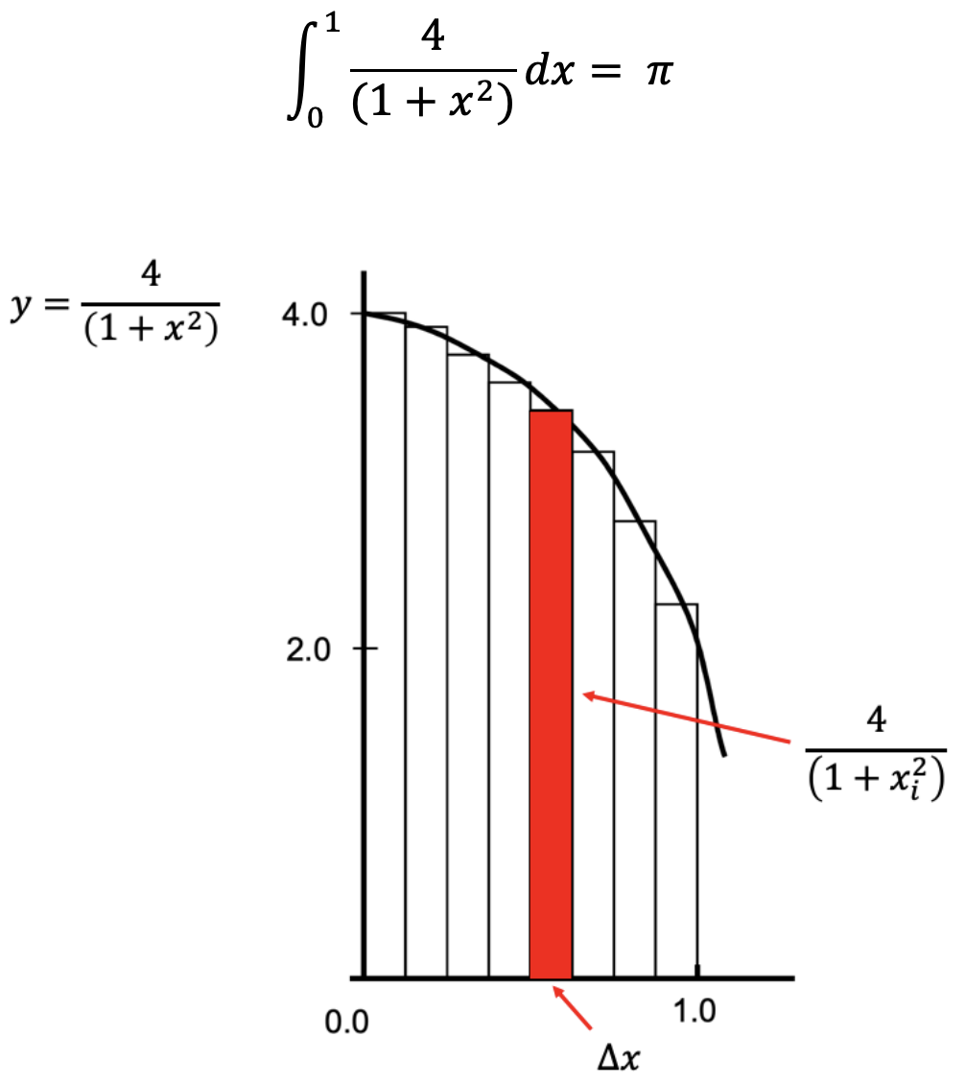
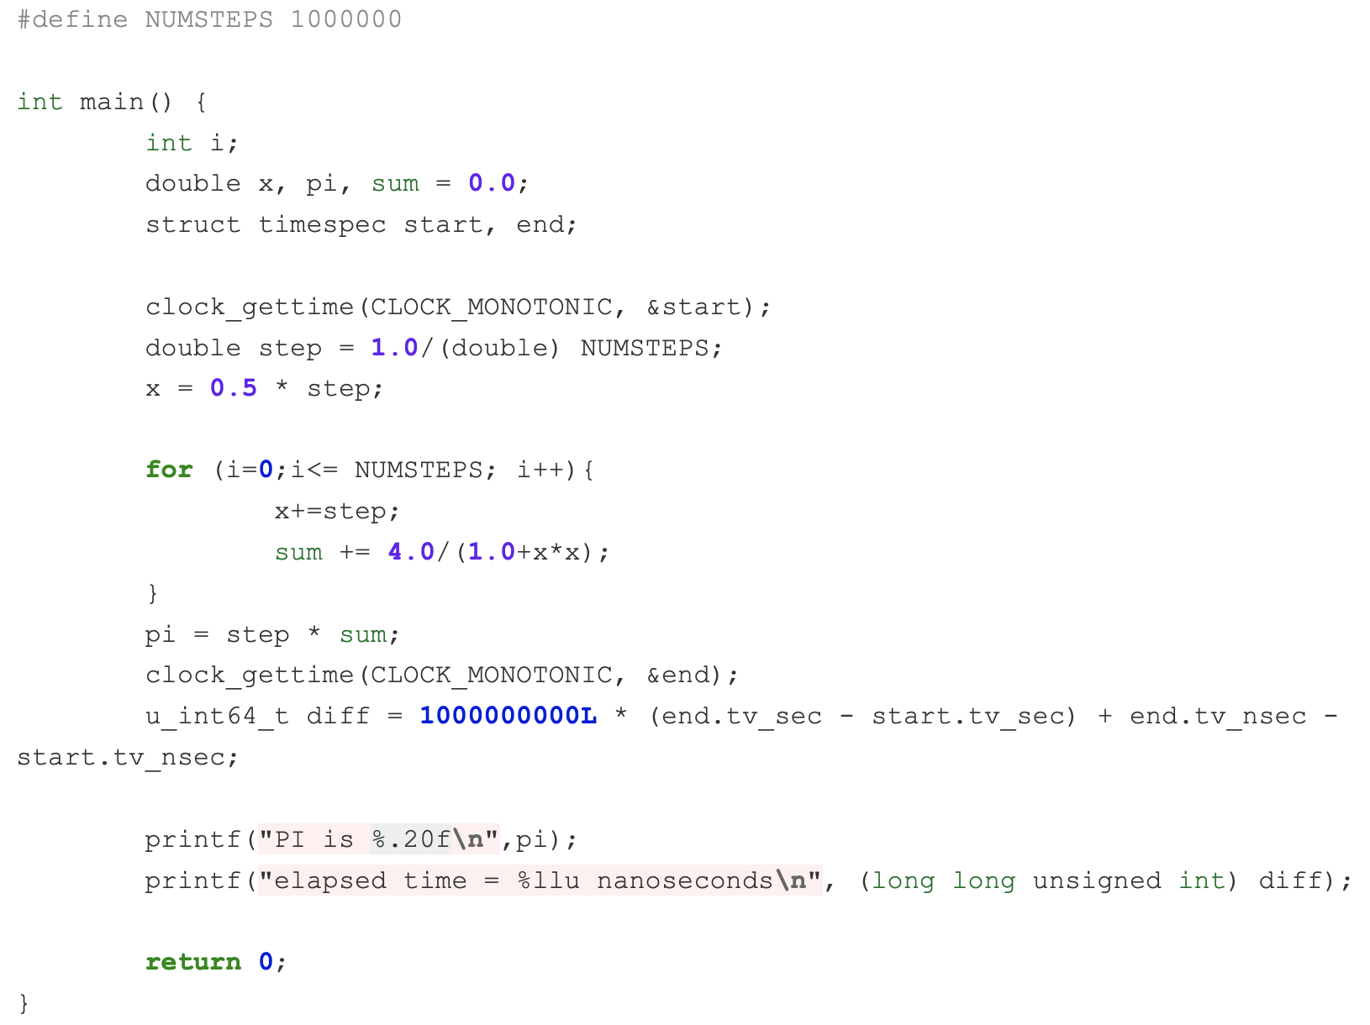
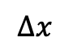
Hint of Project
$$∆x$$
y
size of rectangle

Slide 51
Hint of Project
I send
Rank = 1
Rank = 2
Rank = n
Rank = 0
I receive

Slide 52
Hint of Project
Rank = 1
Rank = 2
Rank = n

Slide 53
Hint of Project
MPI_Bcast: broadcast information to all threads
MPI_Reduce: sum up results together

Slide 54
Overview
Distributed coordination
Distributed scheduling
Distributed management
Distributed Computation
Distributed Storage
Distributed Communication
Distributed Resources

